Slide 1


Primary Flight Training
Ground School

Slide 2
Basic Maneuvers

Slide 3
Basic Maneuvers
The TURN
STRAIGHT and LEVEL Flight
The GLIDE
The CLIMB
If the student has trouble with any maneuver (e.g., landing) the trouble is likely some flaw in the student’s understanding of the fundamentals
Notes:
The basic maneuvers are tackled according to their importance: 1. Turns, 2. Straight and Level, 3. Gliding, and 4. Climbing

Slide 4
The Turn
Almost all fatal flying accidents are caused by loss
of control during a turn
The rudder cannot turn the UL, it can only produce
a yaw
Involves the coordination of three flight controls –
aileron, rudder, and “elevator”
Notes:
Discusses why turn has to be prioritized and understood completely among the basic maneuvers

Slide 5
QUESTION
How then is an airplane turned?
An airplane is turned by laying it over on its side and lifting it around through back pressure on the stick

Slide 6
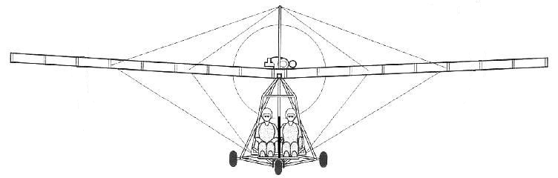
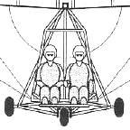
The Turn
Changing the direction of the wing's lift toward one side or the other, the airplane will be pulled in that direction
Notes:
Moving the ailerons to bank the plane changes the direction of lift of the wing with the aileron that is lowered

Slide 7
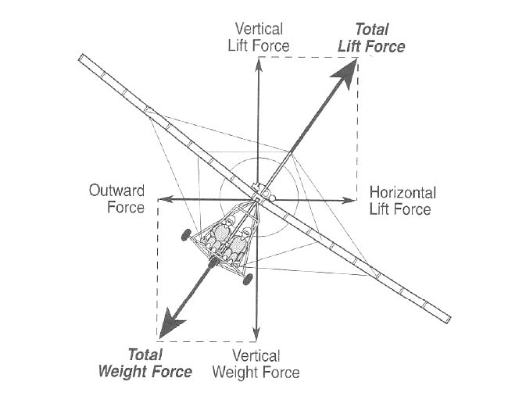
The Turn
At straight and level, the total lift is acting perpendicular to the
wings and to the earth
As the airplane is banked into a turn, the lift then becomes the
resultant of two components:
  One, the vertical component, continues to act
  perpendicular to the earth and opposes gravity
  The other, the horizontal component, acts parallel to the
  earth's surface and opposes centrifugal force caused by
  the turn
These two lift components act at right angles to each other,
causing the resultant lifting force to act perpendicular to the
banked wing of the airplane
It is this lifting force that actually turns the airplane - not the rudder
Notes:
Discusses the two forces involved in a turn, the force to keep the wings up and the force to shove it sidewards

Slide 8
The Turn
The ‘wing force’ (lift) is needed:
  To hold the wing up
  Shove the UL sidewards
However, the ‘wing force’ is not enough to do both jobs, so:
    UL sinks and noses down
    UL slips off to the side toward the bank
  Note: If this continues, this will result in a
  DOWNWARD SPIRAL
Notes:
A simpler, more layman discussion of the two forces involved in a turn, the force to keep the wings up and the force to shove it sidewards

Slide 9
The Turn – Role of the ‘elevator’
BACK PRESSURE in the turn:
  We force the UL to fly at a higher Angle of Attack
  The higher Angle of Attack results to the UL’s wings producing a bigger force
  A bigger ‘wing force’ is now adequate to hold the UL up and shoving it to the side
Result: Level, non-slipping turn (no downward spiral)
Notes:
Discusses the need for back pressure (stick back) during a turn

Slide 10
The Turn – Role of the ‘elevator’
BACK PRESSURE in the turn:
  Smoothness of turn depends on the amount of back pressure
  The steeper the bank, the more back pressure is needed; power can also be added to give sufficient ‘wing force’
  The rudder has no function in all of this
Notes:
Discusses the need for back pressure (stick back) during a turn

Slide 11
REMEMBER THIS!
In the TURN, do not worry about coordination of rudder and aileron;
worry about the coordination of
BACK PRESSURE and BANK!

Slide 12
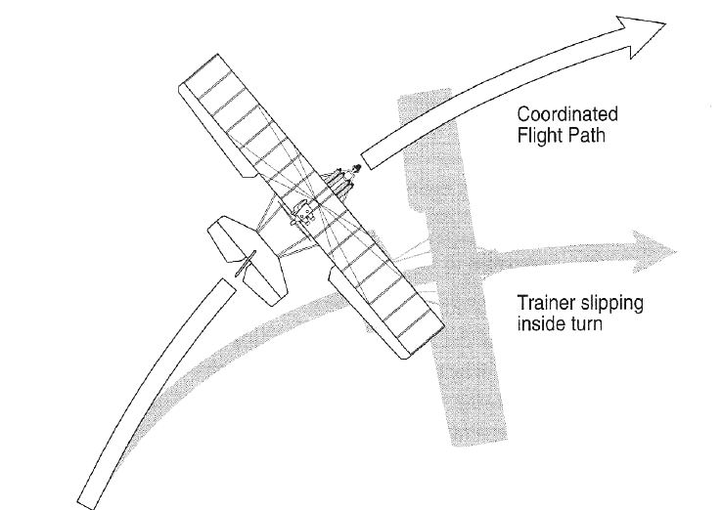
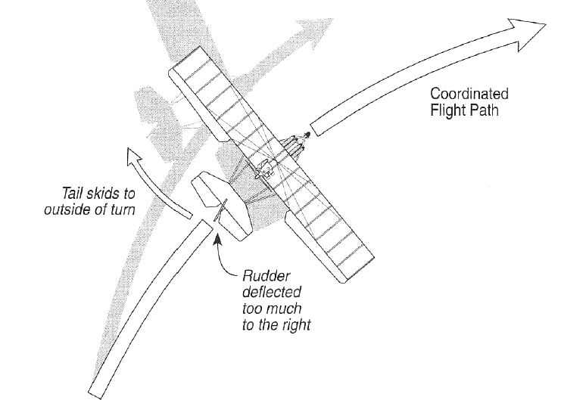
The Turn – Slip and Skid
SLIP
SKID
Not enough rudder for the bank;
(too much aileron)
Not enough back pressure
Airspeed increase; lose altitude
Too much rudder for the bank
Airspeed decreases
More dangerous than SLIP
Can develop into a SPIN
Notes:
Discusses and differentiates between coordinated turns, a slip, and a skid

Slide 13
The Turn – Yaw String
SLIP
SKID
Coordinated turn
Notes:
Discusses and differentiates between coordinated turns, a slip, and a skid and its effect on the yaw string. This will also introduce the students on how to properly react to the yaw string (e.g., if string is pointed to the left, apply right rudder to correct)

Slide 14
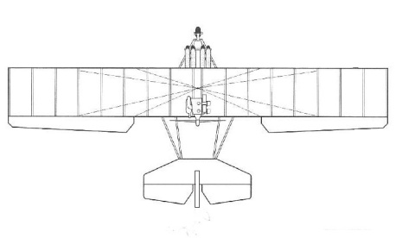
The Turn
In the turn: bank + back pressure
Straight and level
Roll in: aileron + rudder
Roll out: aileron + rudder
Notes:
This shows the proper use of aileron + rudder (going in and out of the turn) and back pressure + turn

Slide 15
Straight & Level Flight
How to level-off from a climb:
Nose down until at desired airspeed. Then adjust throttle for level flight
Upon reaching desired altitude, set throttle to desired RPM (cruising). Then by elevator, raise/lower nose for airspeed
Procedure for level flight:
Pilot holds his stick; hence also holds airspeed
Regulate altitude by retarding/advancing the throttle

Slide 16
Straight & Level Flight
How to fly straight:
The pilot selects two or more outside visual reference points directly ahead of the UL (such as fields, towns, lakes, or mountains, to form points along an imaginary line) and keeps the airplane's nose headed along that line
Notes:
Discusses the technique to maintain straight flight relative to the ground

Slide 17
Straight & Level Flight
How to fly level:
Select a reference point (e.g., the top of your shoe, instrument panel, etc.) and then keep that point in a fixed position relative to the horizon. That position should be cross checked occasionally against the altimeter to determine whether or not the pitch attitude is correct
Notes:
Discusses the technique to maintain a level flight relative to the horizon

Slide 18
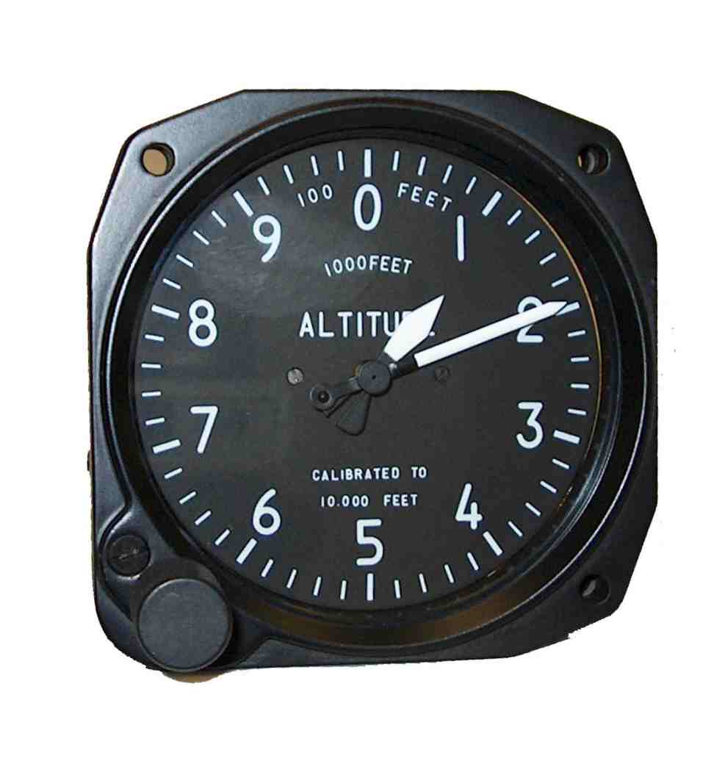
Straight & Level Flight
Glance at your altimeter only
for a few seconds
Do not freeze your attention
on it
90% should be spent looking
out (ground, horizon, etc.)
For the student: Study the
altimeter face –
ON THE GROUND
Altimeter at
1,200 ft.
Notes:
Reminders on using the gauges in flight. At most the pilot should only look at his instruments 10% of the time (or just six seconds per one minute of flight)

Slide 19
The Glide
Difficulties of the glide are twofold:
PERCEPTION – the inexperienced eye cannot gauge exactly where the UL is going
PROBLEM OF CONTROL – in a glide the UL’s response to the stick is almost directly contrary to “common sense”
Notes:
Introduction to the glide and how our land-based experiences make it difficult to master this maneuver. We have to change our perception and instinctive reflexes to properly execute the glide

Slide 20
The Glide
Natural Tendencies:
OVERSHOOT!
UNDERSHOOT!
- point down steeply
- less steep to “stretch” the glide
Notes:
Natural tendencies of the inexperienced student

Slide 21

The Glide – Secret of Glide Control
ACTUAL
PERCEPTION
PERCEPTION
ACTUAL
Notes:
What the students perceive will happen in a glide and what will actually occur in real flight

Slide 22
The Glide – Secret of Glide Control
Most efficient glide – compromise between dangerously slow and awkwardly excessive speeds

Slide 23
The Glide – Secret of Glide Control
If you want to go down more steeply –
point nose down LESS
If you want to go down less steeply –
point nose down MORE
Because this runs contrary to one’s ground experience, it is extremely hard to do
the right thing – specially in an EMERGENCY
when glide control matters
Notes:
New ideas and concepts that the student-pilot has to know by heart since this will be useful in emergencies, when the proper control of the glide matters

Slide 24
The Glide
In an emergency landing, avoid a stall or a spin, get the airplane down to the ground UNDER CONTROL
The only way to KILL yourself in an airplane is to hit the ground nose first

Slide 25
The Climb
There is only one thing that will ever make an airplane go up – ENGINE POWER (the real elevator)

Slide 26
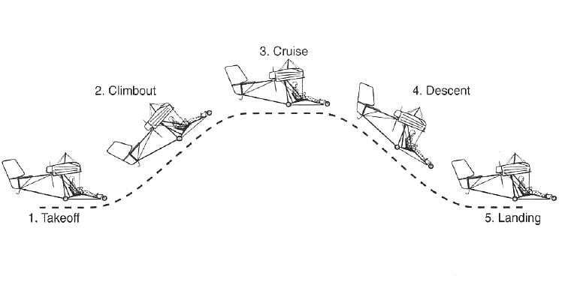
Phases of Flight
Transitions are performed between each phase involving changes in Power and Angle of Attack
Notes:
The five phases of flight

Slide 27
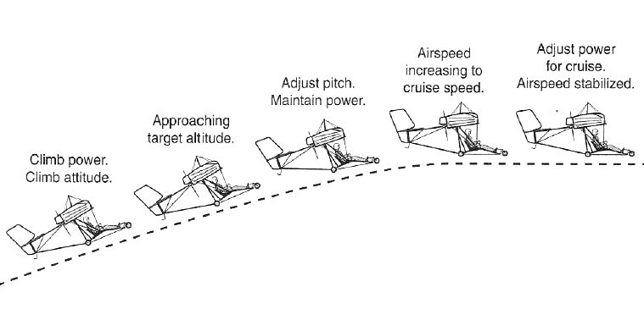
Transition from Climb to Level Flight
Adjust pitch first (lower AOA) when transitioning from climb to level flight
What happens if we reduce power first?
Remember the UL is at a high Angle Of Attack!!

Slide 28
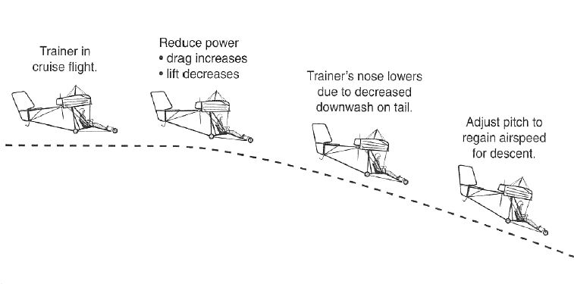
Transition from Level Flight to Descent
Adjust power first when transitioning from level flight to descent

Slide 29
Transition Summary
TO DO | 1 | 2
Climb to Level | Pitch/AOA for airspeed | Power to level
Level to Descent | Reduce power to descend | Pitch/AOA for airspeed
Descent to Level | Power to stop descent | Pitch/AOA for airspeed
Level to Climb | Pitch/AOA for airspeed | Power to climb
Notes:
Summary of the transitions

Slide 30
Next Lesson
Take-Offs
Transitions
Landings
Notes:
Summary of the transitions

